Slide 1
SRI ESHWAR LECTURE
NOTES APP

Slide 2
OUTLINE
ABSTRACTION
OBJECTIVE
INTRODUCTION
EXPLANATION
REQUIREMENT
EXISTING SYATEM
PROPOSED SYSTEM

Slide 3
ABSTRACTION
The aim of the project is to attach the study materials of all the subjects of the wards.
If this app is implemented it is very useful to the college wards.

Slide 4
OBJECTIVE
All the study materials is available so that the students can learn faster than the usual reference.

Slide 5
INTRODUCTION
This app is very useful in future because all the study materials are available previously so that the doubts can be cleared as soon as possible.

Slide 6
EXPLANATION
It helps the wards in the college to prepare the semesters or internals examinations without any hesitation, by having materials like PPT (or) PDF etc . . . .
Easy references
Inneed to refer from peoples.

Slide 7
EXSISTING SYSTEM
The current scenario is the students used to get the materials before the exam, so that they cannot concentrate well.
The wards cannot get sufficient marks in the exams

Slide 8
PROPOSED SYSTEM
If this app is implemented the materials can be used through this app.
We need to conform that several attachments like pdf , ppt , wordexel can be possilbe through this app.

Slide 9
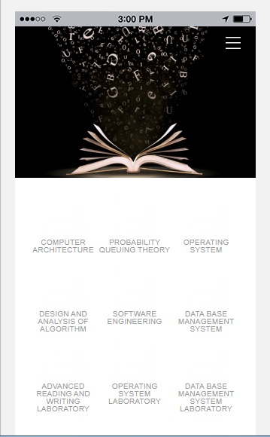
SAMPLE VIEW

Slide 10
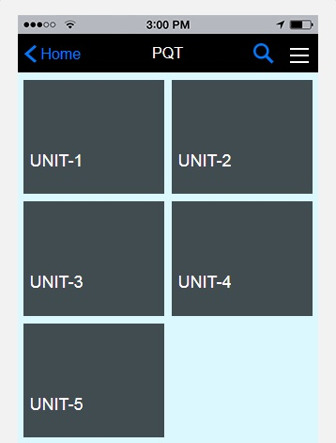

Slide 11
